Slide 1
Angular Training
Angular Pipe
Chee Guan, Ang
Angular Pipe
October 8 2020

Slide 2
Angular Pipe
Overview
Use Pipe "|" syntax
Simple functions you can use in template expression to accept an input value and return a transformed value
takes integers, strings, arrays, date, any form of data as input separated with "|".
Transforms the data with the Pipe function without changing the original data and return the new transformed data to the browser display

Slide 3
Angular Pipe
Angular Built-in Pipe
Lowercasepipe
Uppercasepipe
Datepipe
Currencypipe
Jsonpipe
Percentpipe
Decimalpipe
Slicepipe
i18nSelect - Generic selector that displays the string that matches the current value.
...

Slide 4
Angular Pipe
Built-in Pipe
DEMO

Slide 5
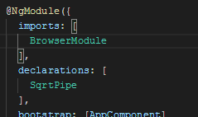
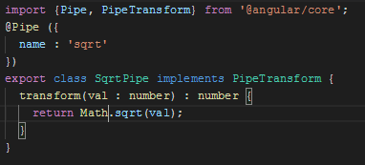

Angular Pipe
Custom Pipe
1. Create a Pipe and implements "PipeTransform" interface
2. Declare in Module
Result
3. Use it with Pipe syntax "|"

Slide 6
Angular Pipe
Customer Pipe
DEMO

Slide 7
Angular Pipe
Q&A?

